Slide 1
Comparing Song Audio Features to Rankings on The Billboard Hot 100
Kevin Carr 501150122
Supervisor: Ceni Babaoglu, PhD

Slide 2




The Central Problem
Can we predict commercial success using audio feature data?
?

Slide 3
The Project Approach
Compile and clean the data
Exploratory data analysis
Remove outliers
Cluster into groups
Create classification models
Evaluate performance

Slide 4
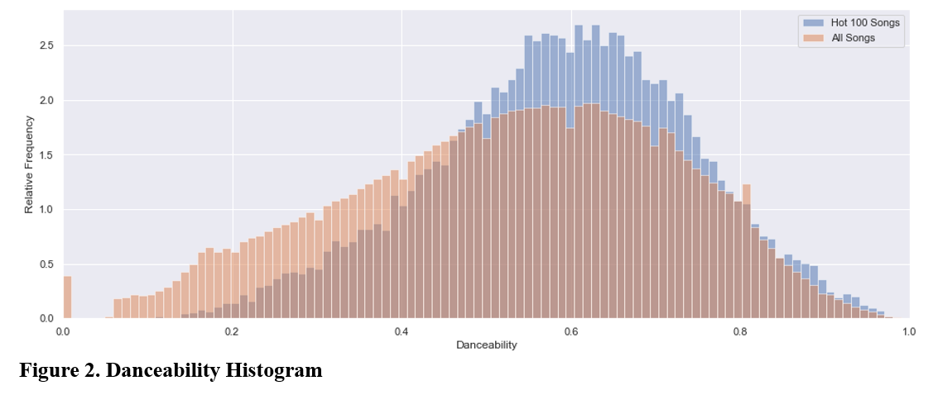
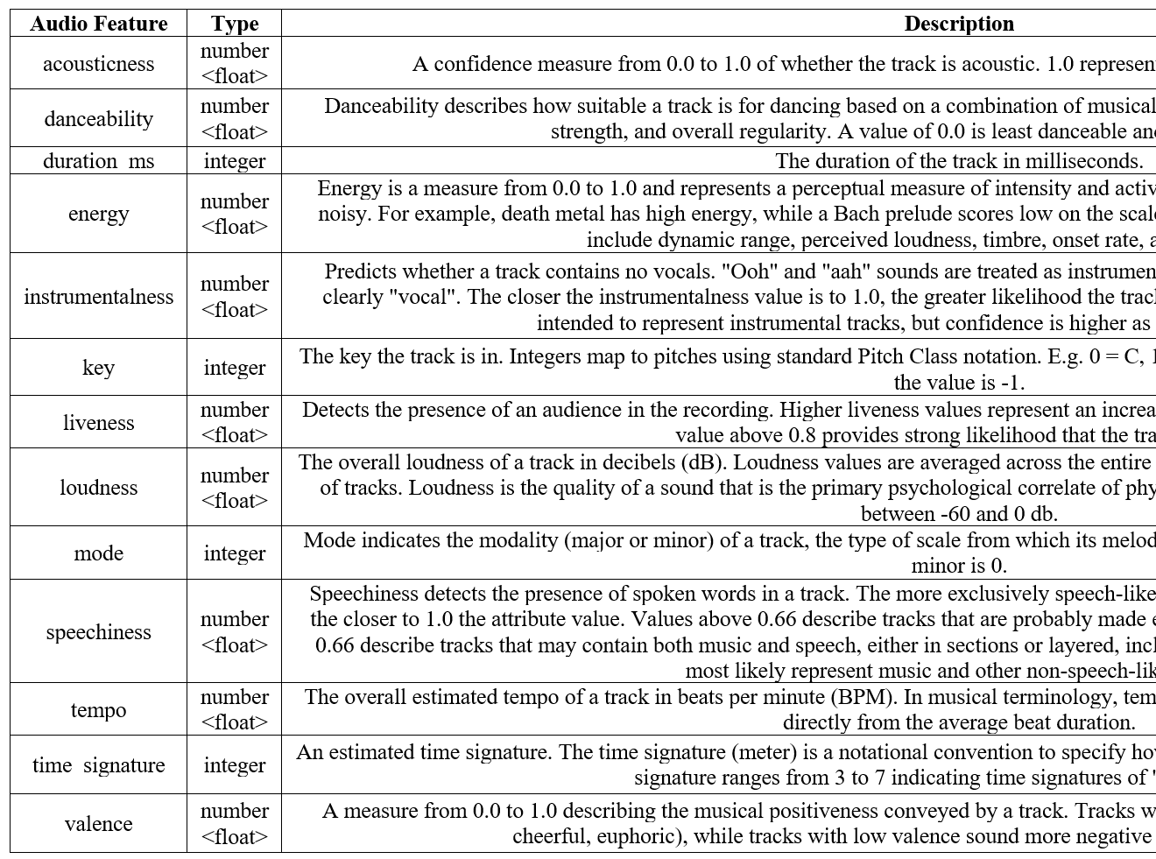
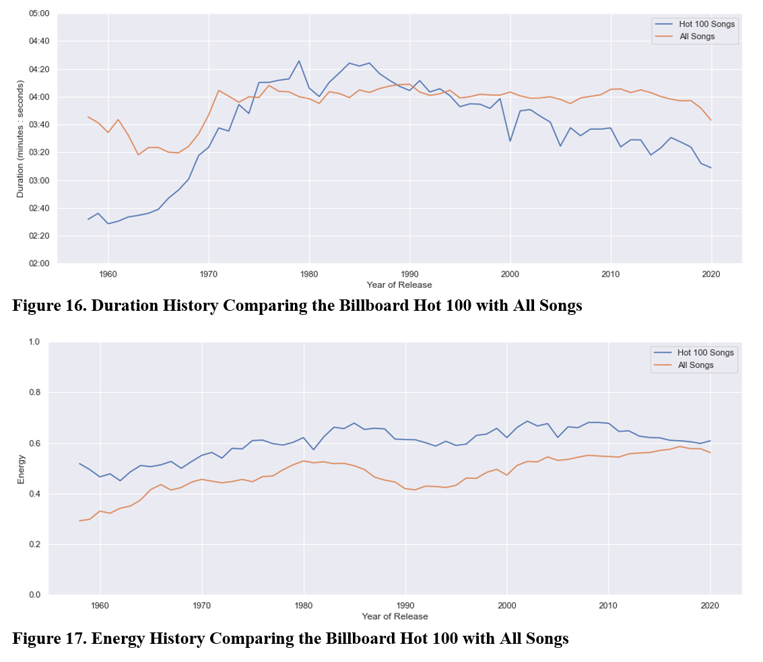
The Data

Slide 5
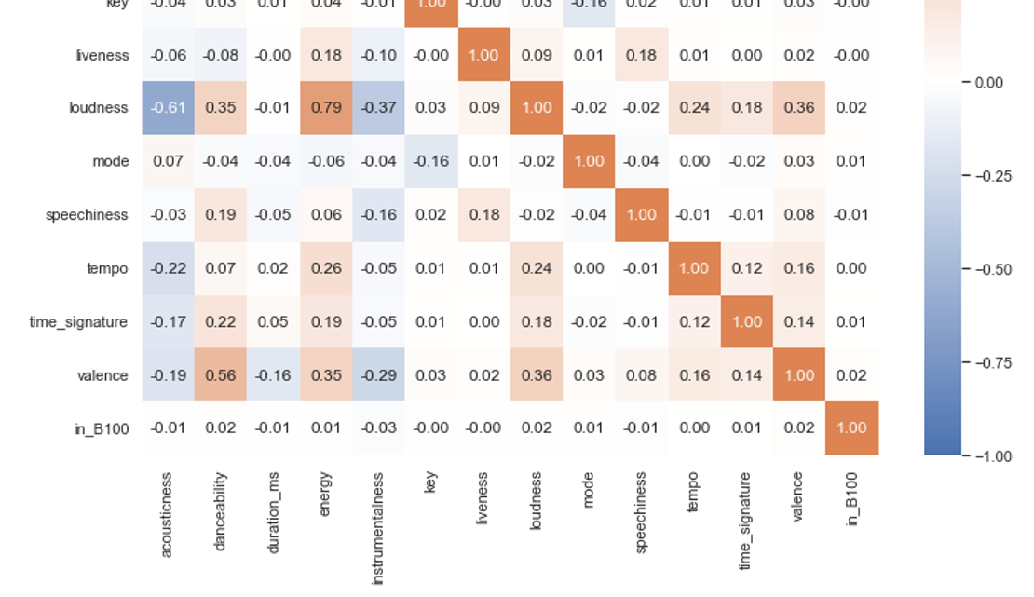
The Data

Slide 6
Clustering Approach
Removed outliers
Non-musical tracks (e.g., “ringtone”)
Non-song music (e.g., “TV theme”)
Clustered into 3 groups
K-Means clusters, optimised by silhouette score
K-Means clusters, equal to number of genres
Manual clusters, grouped into genres

Slide 7
Classification Approach
Cross-validation
Split data into 5 stratified folds
Consistent random seed for consistency between tests
Train the model using 4 of the folds
Balanced using undersampling (using consistent random seed)
Predict the class
Predict using the unbalanced test fold
Repeat for each fold
Save all out-of-fold predictions for model evaluation

Slide 8
Classification Models / Scenarios
Logistic Regression – Default Hyperparameters
Decision Tree – Default Hyperparameters
K-Nearest Neighbours – Default Hyperparameters
Random Forest – Default Hyperparameters
AdaBoost – Default Hyperparameters
Logistic Regression – Tuned Hyperparameters
Decision Tree – Tuned Hyperparameters
Logistic Regression – Clustered By K-Means Version 1
Logistic Regression – Clustered By K-Means Version 2
Logistic Regression – Clustered By Genre

Slide 9
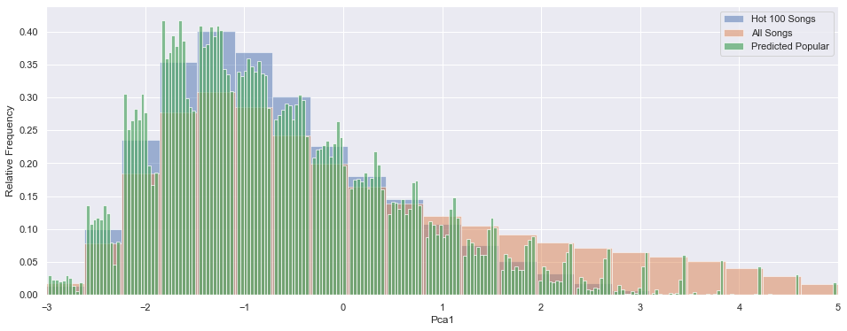
Findings
Most models made predictions consistent with observed data
First Principal Component

Slide 10
Findings
Low precision was unavoidable
“Popularity” is highly unbalanced by definition
“Popular” songs span a large range of audio features
Notes:
“Popularity” is highly unbalanced by definition
“Popular” songs have a large range of audio features

Slide 11
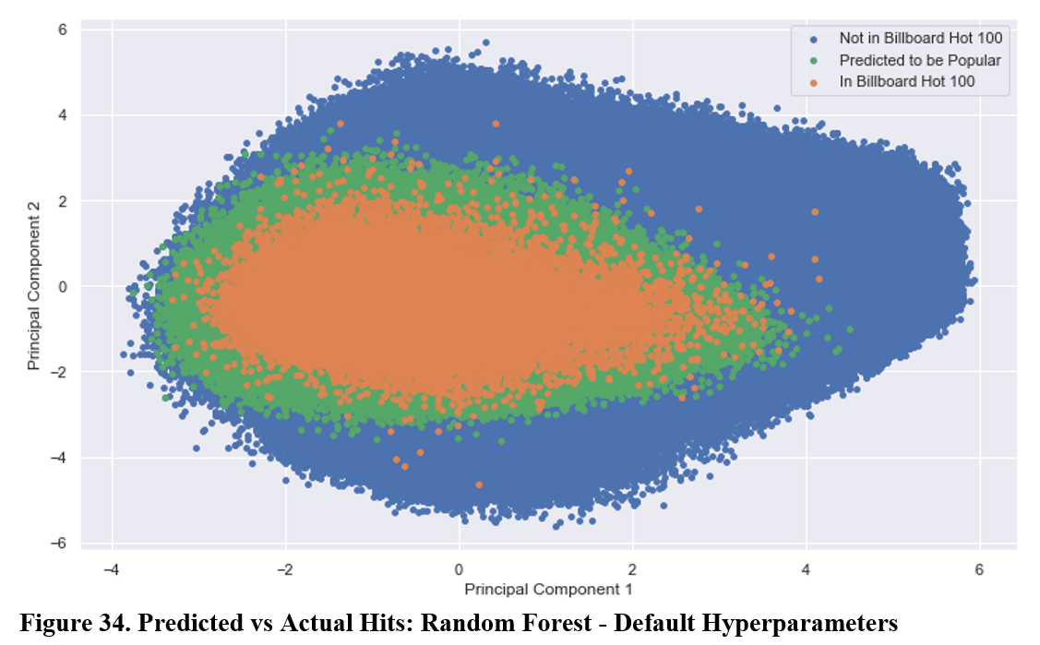
Findings
“Popular” songs span a large range of audio features
Notes:
“Popularity” is highly unbalanced by definition
“Popular” songs have a large range of audio features

Slide 12
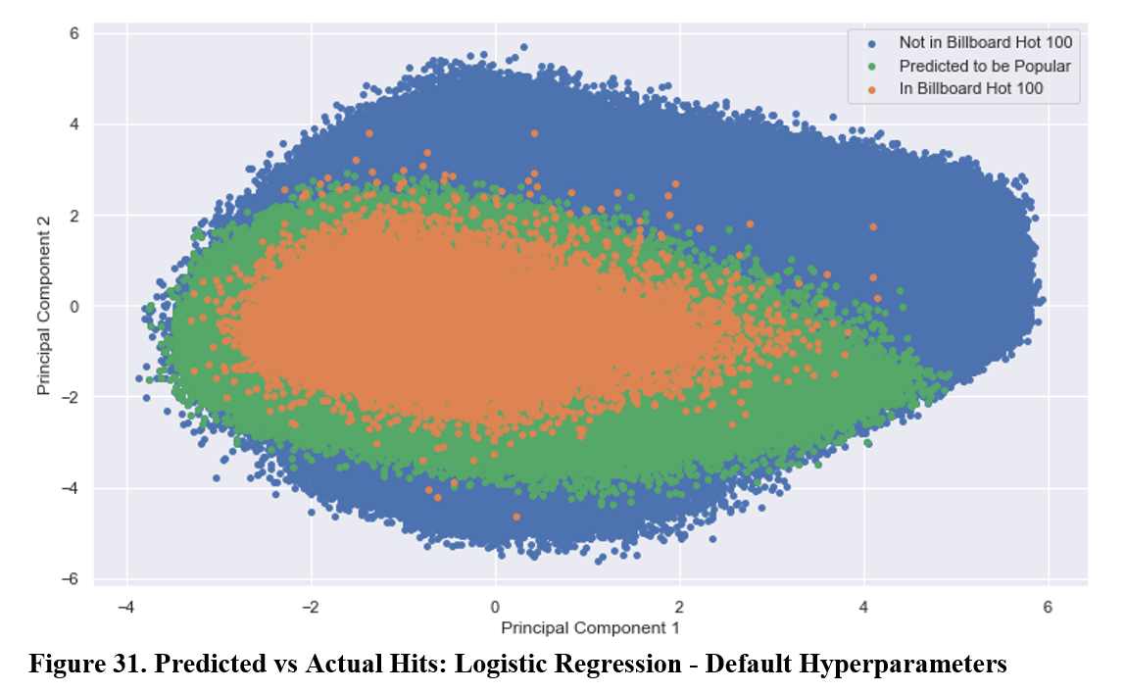
Findings
Clustering did not improve performance

Slide 13
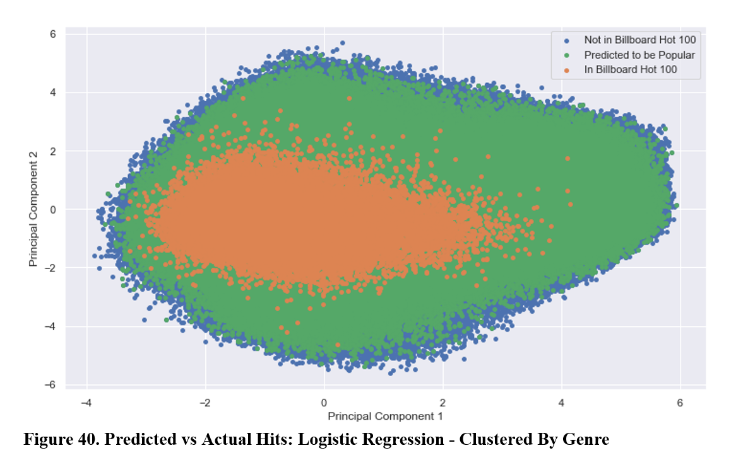
Findings
Clustering did not improve performance

Slide 14
Discussion and Conclusions
The Random Forest performed best
Most models had similar scores
Undersampling was required to achieve non-trivial results

Slide 15
Future Work
An optimized Random Forest could perform well
This would unfortunately take a long time to tune
A plugin for music software could be useful for musicians
Limitations include calculating audio features from raw audio
PCA could be useful for accuracy and/or speed

Slide 16
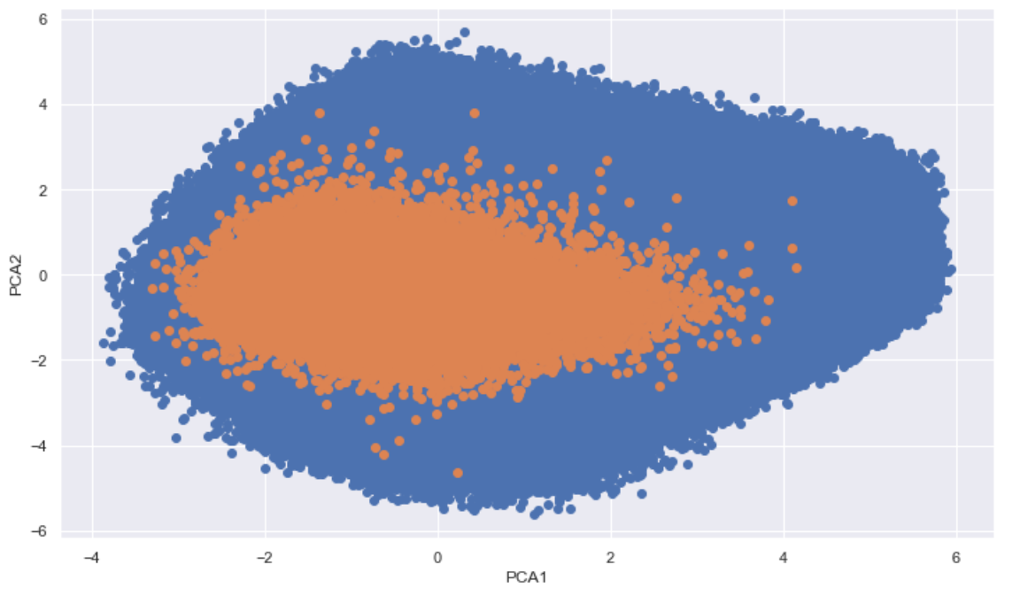
Future Work
An analytical PCA model could predict whether a song has the potential for commercial success

Slide 17
Thank you!

Slide 18
Any questions?

